Slide 1
Behavioural Patterns

Slide 2
Mediator

Slide 3
Mediator
Intent
Define an object that encapsulates how a set of objects interact. Mediator promotes loose coupling by keeping objects from referring to each other explicitly, and it lets you vary their interaction independently.
Motivation
Object-oriented design encourages the distribution of behavioramong objects
Consider the implementation of dialog boxes in a graphical user interface. A dialog box uses a window to present acollection of widgets such as buttons, menus, and entry fields,

Slide 4
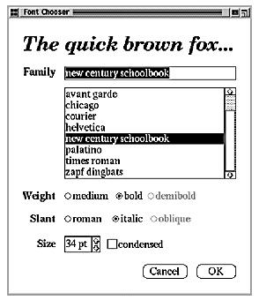
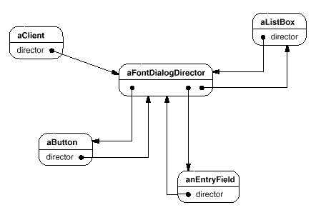
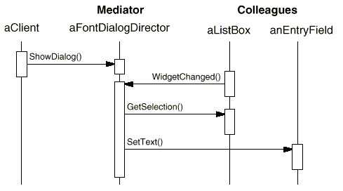

Slide 5
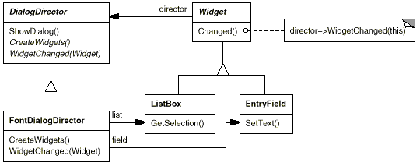
The list box tells its director that it's changed.
The director gets the selection from the list box.
The director passes the selection to the entry field.
Now that the entry field contains some text, the directorenables button(s) for initiating an action (e.g., "demibold," "oblique").

Slide 6
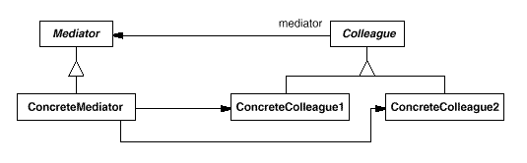
Applicability
A set of objects communicate in well-defined but complex ways. The resulting interdependencies are unstructured and difficult to understand.
Reusing an object is difficult because it refers to and communicates with many other objects.
A behavior that's distributed between several classes should
be customizable without a lot of sub classing
Structure

Slide 7
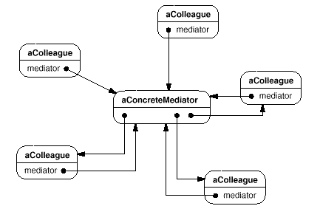
Object structure
Participants
Mediator (DialogDirector)
ConcreteMediator (FontDialogDirector)
Colleague classes (ListBox, EntryField)
Collaborations

Slide 8
Consequences
It limits sub classing
It decouples colleagues.
It simplifies object protocols
It abstracts how objects cooperate
It centralizes control
Implementation
Omitting the abstract Mediator class
Colleague-Mediator communication
Sample Code, Known Uses
Related Patterns: Façade and Colleagues can communicate with the mediator using the Observer pattern

Slide 9
Iterator

Slide 10
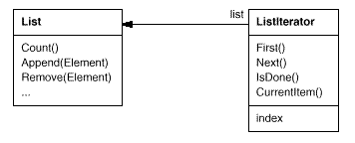
Iterator
Intent
Provide a way to access the elements of an aggregate object sequentially without exposing its underlying representation.
Also Known As, Cursor
Motivation
A List class would call for a ListIterator with the following relationship between them:

Slide 11
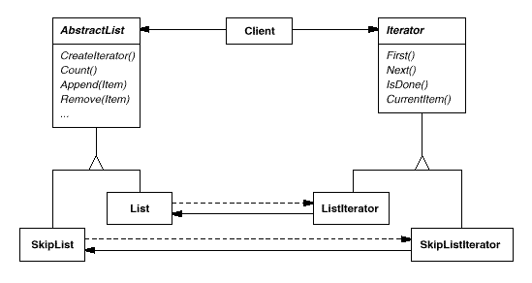
Iterator concept to support polymorphic iteration
Applicability
To access an aggregate object's contents without exposing its internalrepresentation.
To support multiple traversals of aggregate objects.
To provide a uniform interface for traversing different aggregate structures (that is, to support polymorphic iteration).

Slide 12
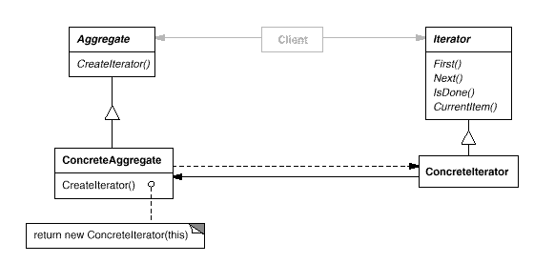
Structure
Participants
Iterator
Concrete Iterator
Aggregate
Concrete Aggregate
Collaborations

Slide 13
Consequences
It supports variations in the traversal of an aggregate
Iterators simplify the Aggregate interface
More than one traversal can be pending on an aggregate
Implementation
Who controls the iteration? External and Internal
Who defines the traversal algorithm
How robust is the iterator?
Additional Iterator operations.
Using polymorphic iterators in C++.
Iterators may have privileged access
Iterators for composites
Null iterators
Sample Code, Known Uses
Related Patterns: Composite, Factory Method, Memento.

Slide 14
Observer

Slide 15
Observer
Intent
Define a one-to-many dependency between objects so that when one object changes state, all its dependents are notified and updated automatically.
Also Known As
Dependents, Publish-Subscribe.
Motivation
Subject and Observer
Interaction is also known as Publish-Subscribe. The subject is the publisher of notifications.

Slide 16
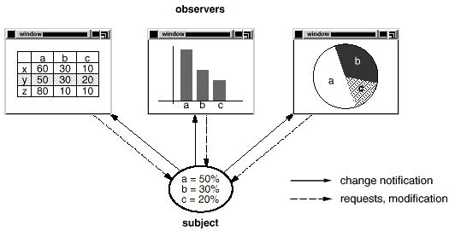
Applicability
· When an abstraction has two aspects, one dependent on the other. Encapsulating these aspects in separate objects lets you vary and reuse them independently.
· When a change to one object requires changing others, and you don't know how many objects need to be changed.
· When an object should be able to notify other objects without making assumptions about who these objects are. In other words, you don't want these objects tightly coupled.

Slide 17
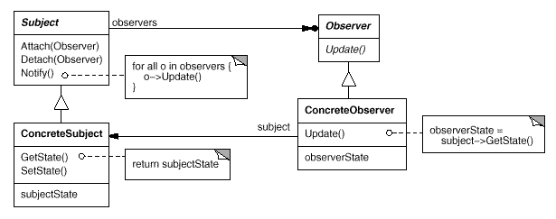
Structure
Participants
Subject
Observer
Concrete Subject
Concrete Observer

Slide 18
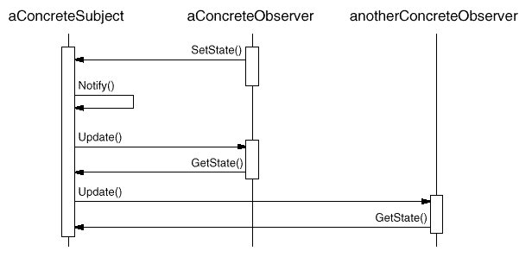
Collaborations
Consequences
Abstract coupling between Subject and Observer
Support for broadcast communication
Unexpected updates

Slide 19
Implementation
Mapping subjects to their observers
Observing more than one subject
Who triggers the update?
Dangling references to deleted subjects
Making sure Subject state is self-consistent before notification
Avoiding observer-specific update protocols
Specifying modifications of interest explicitly
Encapsulating complex update semantics – Change Manager

Slide 20
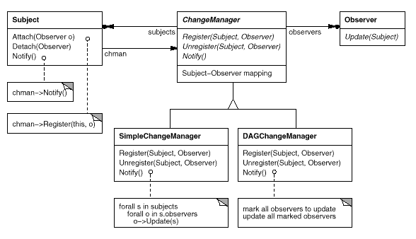
Combining the Subject and Observer classes
Sample Code, Known Uses
Related Patterns: Mediator and Singleton

Slide 21
Chain of Responsibility

Slide 22
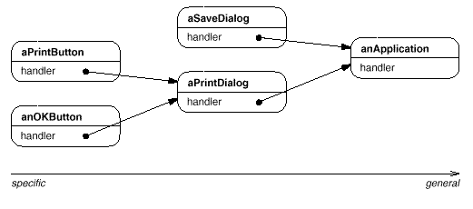
Chain of Responsibility
Intent
Avoid coupling the sender of a request to its receiver by giving more than one object a chance to handle the request. Chain the receiving objects and pass the request along the chain until an object handles it.
Motivation

Slide 23
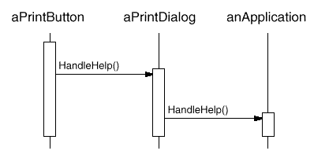
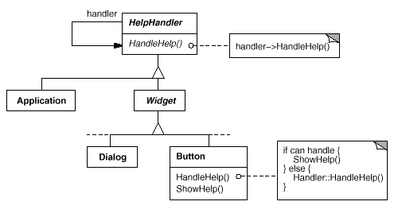

Slide 24
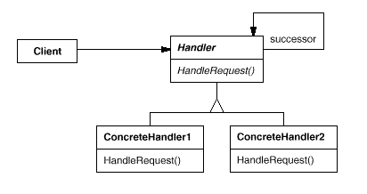
Applicability
More than one object may handle a request, and the handler isn't known a priori. The handler should be ascertained automatically.
To issue a request to one of several objects without specifying the receiver explicitly.
The set of objects that can handle a request should be specified dynamically.
Structure

Slide 25
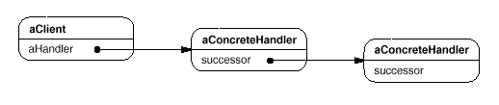
Participants
Handler (HelpHandler)
ConcreteHandler (PrintButton, PrintDialog)
Client
Collaborations
Consequences
Reduced coupling
Added flexibility in assigning responsibilities to objects
Receipt isn't guaranteed
Implementation
Implementing the successor chain.
Connecting successors
Representing requests
Automatic forwarding in Smalltalk
Sample Code, Known Uses: Related Patterns: Composite

Slide 26
Command

Slide 27
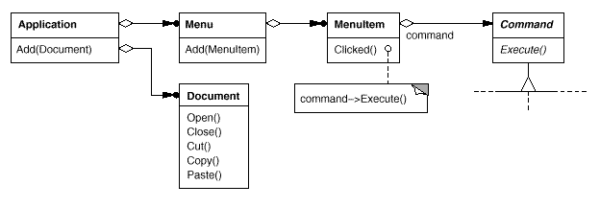
Command
Intent
Encapsulate a request as an object, thereby letting you parameterize clients with different requests, queue or log requests, and supportundoable operations.
Also Known As: Action, Transaction
Motivation

Slide 28
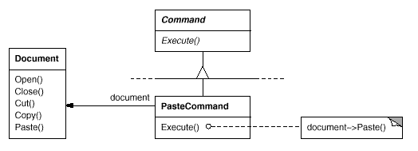
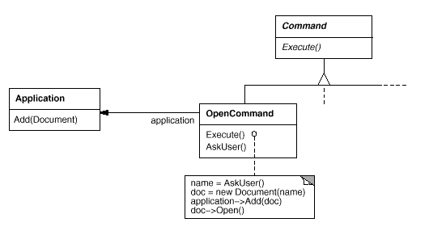
Paste Command supports pasting text from the clip board into a Document.
Open Command's Execute operation is different.

Slide 29
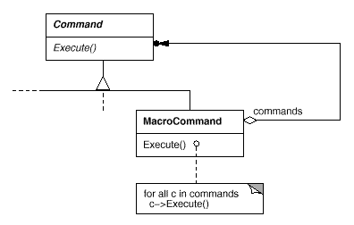
Macro Command is a concrete Command subclass that simply executes a sequence of Commands
Applicability
parameterize objects by an action to perform, as MenuItem
objects did above - callback function
specify, queue, and execute requests at different times.
support undo
support logging changes so that they can be reapplied in case of a system crash.
structure a system around high-level operations built on primitives
operations. Such a structure is common in information systems that support transactions.

Slide 30
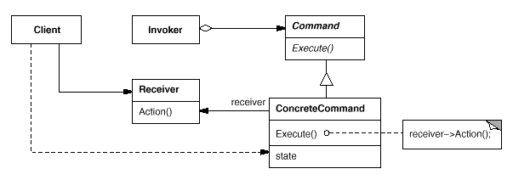
Structure
Participants
· Command
· ConcreteCommand (PasteCommand, OpenCommand)
Client (Application)
· Invoker (MenuItem)
· Receiver (Document, Application)

Slide 31
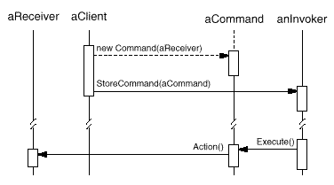
Collaborations
Consequences
Command decouples the object that invokes the operation from the one that knows how to perform it.
Manipulated and extended like any other object.
Assemble commands into a composite command.
It's easy to add new Commands.

Slide 32
Implementation
How intelligent should a command be?
Supporting undo and redo
Avoiding error accumulation in the undo process
Using C++ templates
Sample Code, Known Uses
Related Patterns
Composite, Memento, Prototype .

Slide 33
Interpreter

Slide 34
Interpreter
Intent
Given a language, define a representation for its grammar along with an interpreter that uses the representation to interpret sentences in the language.
Motivation
Searching for strings that match a pattern is a common problem.
Regular expressions are a standard language for specifying patterns of strings.
Suppose the following grammar defines the regular expressions:
-expression ::= literal | alternation | sequence | repetition |
'(' expression ')'
alternation ::= expression '|' expression
sequence ::= expression '&' expression
repetition ::= expression '*'
literal ::= 'a' | 'b' | 'c' | ... { 'a' | 'b' | 'c' | ... }*

Slide 35
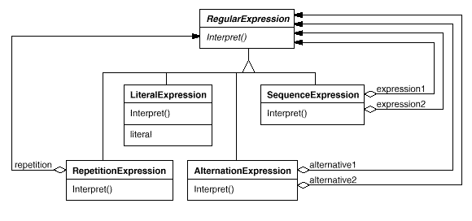
The grammar is represented by five classes:
An abstract class Regular Expression and its four subclasses Literal Expression, Alternation Expression, Sequence Expression, and Repetition Expression.

Slide 36
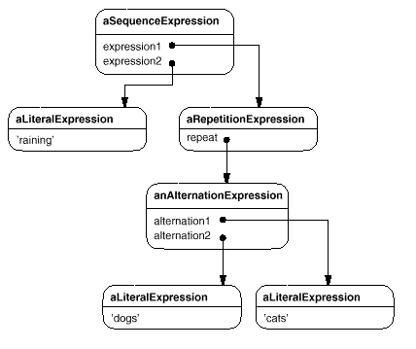
An abstract syntax tree made up of instances of these classes.
represents the regular expression
raining & (dogs | cats) *

Slide 37
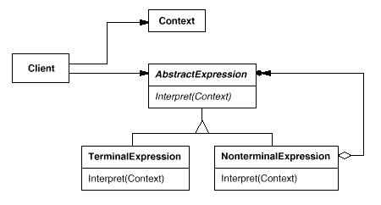
Applicability
The grammar is simple
efficiency is not a critical concern, regular expressions are often transformed into state machines.
Structure

Slide 38
Participants
Abstract Expression (RegularExpression)
Terminal Expression (LiteralExpression)
NonterminalExpression
(AlternationExpression, RepetitionExpression, SequenceExpressions)
Context
Client
Collaborations
The client builds (or is given) the sentence as an abstract syntax tree of Nonterminal Expression and Terminal Expression instances.
The Interpret operation of each Terminal Expression defines the base case in the recursion

Slide 39
Consequences
It's easy to change and extend the grammar
Implementing the grammar is easy, too.
Complex grammars are hard to maintain.
Adding new ways to interpret expressions.
Implementation
Creating the abstract syntax tree
Defining the Interpret operation - Visitor
Sharing terminal symbols with the Flyweight pattern
Sample Code, Known Uses
Related Patterns
Composite, Flyweight, Iterator, Visitor.

Slide 40
Memento

Slide 41
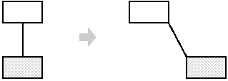
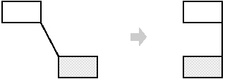
Memento
Intent
Without violating encapsulation, capture and externalize an object's internal state so that the object can be restored to this state later.
Also Known As, Token
Motivation

Slide 42
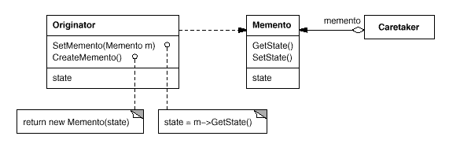
Applicability
A snapshot of (some portion of) an object's state must be saved so that it can be restored to that state later, and
A direct interface to obtaining the state would expose implementation details and break the object's encapsulation.
Structure

Slide 43
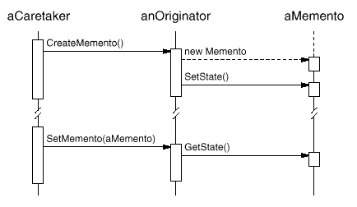
Participants
Memento (SolverState)
Originator (ConstraintSolver)
Caretaker (undo mechanism)
Collaborations

Slide 44
Consequences
Preserving encapsulation boundaries It simplifies Originator
Using mementos might be expensive
Defining narrow and wide interfaces.It
Hidden costs in caring for mementos.
Implementation
Language support
Storing incremental changes
Sample code, Known uses
Related Patterns:
Command and Iterator

Slide 45
State

Slide 46
State
Intent
Allow an object to alter its behaviour when its internal state changes. The object will appear to change its class.
Also Known As, Objects for States
Motivation

Slide 47
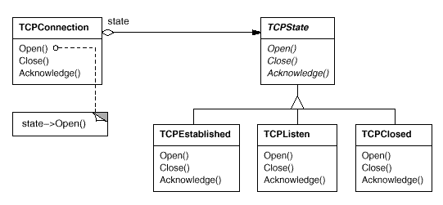
Applicability
An object's behavior depends on its state, and it must change its behavior at run-time depending on that state.
Operations have large, multipart conditional statements that depend on the object's state. This state is usually represented by one or more enumerated constants.

Slide 48
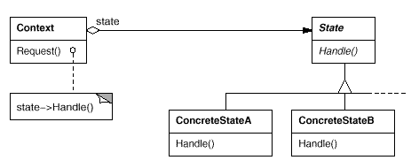
Structure
Participants
Context (TCPConnection)
State (TCPState)
ConcreteState subclasses (TCPEstablished, TCPListen, TCPClosed)

Slide 49
Consequences
It localizes state-specific behavior and partitions behavior for different states
It makes state transitions explicit
State objects can be shared
Implementation
Who defines the state transitions?
A table-based alternative.
Creating and destroying State objects.
Using dynamic inheritance
Sample Code, Known Uses
Related Patterns, Flyweight and Singletons.

Slide 50
Strategy

Slide 51
Template Method

Slide 52
Visitor

